Slide 1
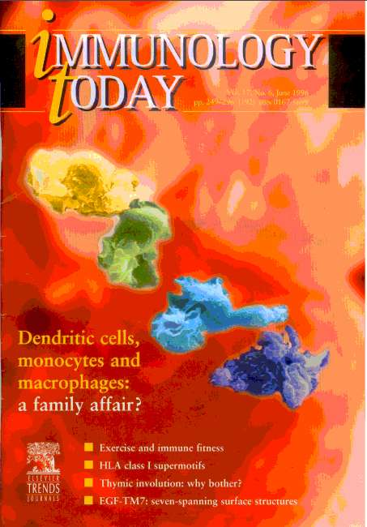
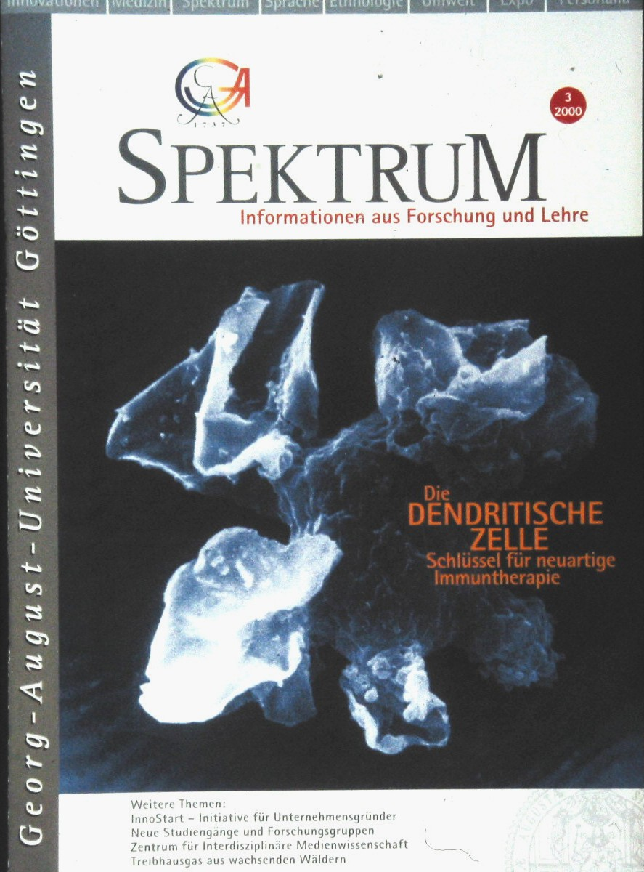
Acceptance
1996
2000

Slide 2
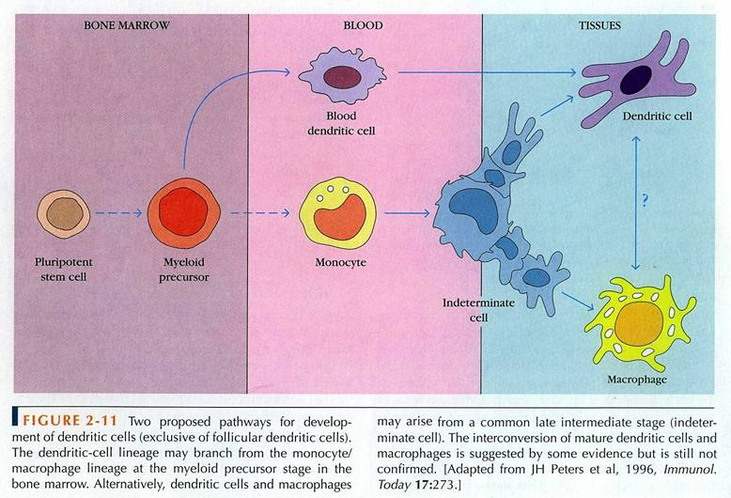
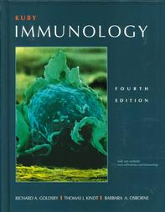
Monocyte-Derived Dendritic Cells:
from Review to the Text Book
R.A. Goldsby, T.J. Kindt, Barbara A. Osborne: Kuby Immunology, 4th Ed. 2000 p. 46

